Slide 1

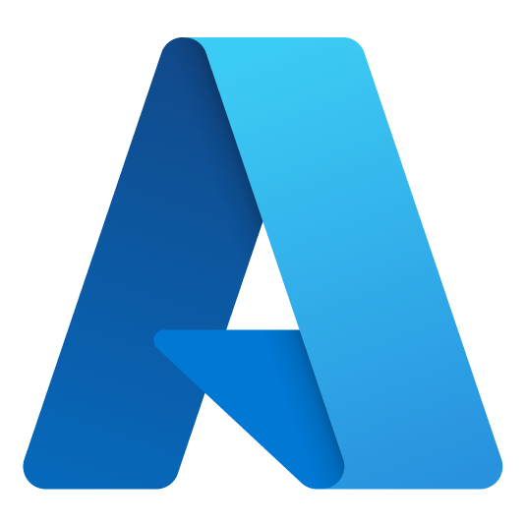
AKS Dev Day
Notes:
Welcome to Azure Dev Day

Slide 2




Larry Wall
Cloud Solution Architect
Azure Dev Day
Larry.wall@microsoft.com
https://www.linkedin.com/in/larry-wall-58525911
https://github.com/larrywa

Slide 3

Randy Patterson
Cloud Solution Architect
Azure Dev Day
Randy.Patterson@microsoft.com
https://www.linkedin.com/in/randyrpatterson/
https://github.com/RandyPatterson

Slide 4
Devs
Notes:
Today is all about YOU – developers
Even if you’re not a dev today should be helpful for you
3 target groups
Never used Azure – gain basic concepts
Familiar with Azure – understand common architectural patterns
Very knowledgeable – pick up some interesting nuggets

Slide 5
Agenda (EST)
9:00 – 9:15 | Intros
9:15 – 9:30 | Container Basics
9:30 – 10:15 | Intro to Kubernetes
10:15 – 10:30 | Break
10:30 – 11:00 | Intro to AKS
11:00 – 11:15 | Deploying Applications to AKS
11:15 – 11:30 | Helm
11:30 – 12:15 | Lunch
12:15 – 1:00 | Lab: Deploying an Application to AKS
1:00 – 1:45 | Lab: Application management with HELM
1:45 – 2:15 | Scaling in AKS
2:15 – 2:30 | Break
2:30 – 3:00 | Lab: Scalability on AKS using HPA
3:00 – 3:30 | Lab: Scaling AKS using KEDA
3:30 – 3:45 | Ingress Controllers
3:45 – 4:00 | Closing thoughts
Notes:
4 content sections today
Each section has
An overview of the solution area
A hands-on lab
Lab is subset of solution area
We’ll also have
Breaks (including lunch)
Lots of FUN!
End around 3:30 Central today

Slide 6

Container Basics

Slide 7
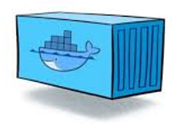
What is a Container?
Portable unit of deployment
Application code and dependencies compartmentalized
Virtualization without the need of a VM overhead
Best practice to organize one service/container
Physical Machine/VM
Container: Product:1.0
Container: Basket:2.0
Container: Product:2.0
Product.API v1
Basket.API v2
Product.API v2
Lib-L v2
Lib-L v3
Lib-L v3
Lib-M v2
Runtime v5
Runtime v7
Runtime v6
Notes:
Portable unit of deployment - Containers are a solution to the problem of how to get software to run reliably when moved from one computing environment to another. This could be from a developer's laptop to a test environment, from a staging environment into production and perhaps from a physical machine in a data center to a virtual machine in a private or public
Application code and dependencies compartmentalized - Simply put, a container consists of an entire runtime environment: an application, plus all its dependencies, libraries and other binaries, and configuration files needed to run it, bundled into one package. By containerizing the application platform and its dependencies, differences in OS distributions and underlying infrastructure are abstracted away.
Virtualization without the need of a VM overhead - With virtualization technology, the package that can be passed around is a virtual machine and it includes an entire operating system as well as the application. A physical server running three virtual machines would have a hypervisor and three separate operating systems running on top of it.
By contrast a server running three containerized applications as with Docker runs a single operating system, and each container shares the operating system kernel with the other containers.
Shared parts of the operating system are read only, while each container has its own mount (i.e., a way to access the container) for writing. Persistent Storage through Volume Mapping
A container may be only tens of megabytes in size, whereas a virtual machine with its own entire operating system may be several gigabytes in size.
Because of this, a single server can host far more containers than virtual machines. Virtual machines may take several minutes to boot up their operating systems and begin running the applications they host, containerized applications can be started almost instantly.
Best practice to organize one service/container
Different versions of software on different environments
Scale out an environment easily
SCALE AS A MONOLITH – today we scale as monolith’s.
DEPLOY WITH ALL THOSE DEPENDENCIES WHICH MAY VARY
Slide Source
https://azure.microsoft.com/en-us/documentation/articles/service-fabric-overview-microservices/
Notes
(1) A monolith app contains domain specific functionality and is normally divided by functional layers such as web, business and data.
(2) You scale monolithic apps by cloning it on multiple servers/VMs/containers.
(3) A microservice application separates functionality into separate smaller services.
(4) This approach scales out by deploying each service independently, creating instances of these services across servers/VMs/containers.
Designing with a microservice approach is not a panacea for all projects, however it does align closer with the business objectives described earlier. Also starting with a monolithic approach may be acceptable if you know that later you have the opportunity to rework the code into a microservice design if necessary. More common is that you have a monolith app today and you can slowly break this apart in stages starting with the functional areas that need to be more scalable or agile.
PUSH THE CONTAINER TO REMOTE MACHINE

Slide 8
Architecture - Traditionally
Your application, could be written in a variety of languages:
Python
NodeJS
.NET full
.NET core
OS
Applications
Services
Kernel
Hardware
Notes:
Explaining the Application portion

Slide 9
Architecture - Traditionally
Long-running processes
Can provide additional functionality to your app
Can assist with interacting with the kernel
OS
Applications
Services
Kernel
Hardware
Notes:
Explaining the Services

Slide 10
Architecture - Traditionally
Provides low-level operations for your app.
Talks to the hardware on behalf of your app
Manages system resources
Drivers
OS
Applications
Services
Kernel
Hardware
Notes:
Talk about Kernel

Slide 11
Architecture -Traditionally -> Containers
OS
Applications
Services
Kernel
Hardware
Container
Package it into a container
Notes:
Transition from the Traditional development to containers involves packaging Apps + Services + Dependencies into a container.
Containers vs. virtual machines | Microsoft Docs

Slide 12
Architecture with Containers
Container
Container
OS
Applications
Services
Applications
Services
Applications
Services
Kernel
Hardware (physical or virtual)
This is our virtualization boundary

Slide 13

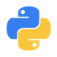
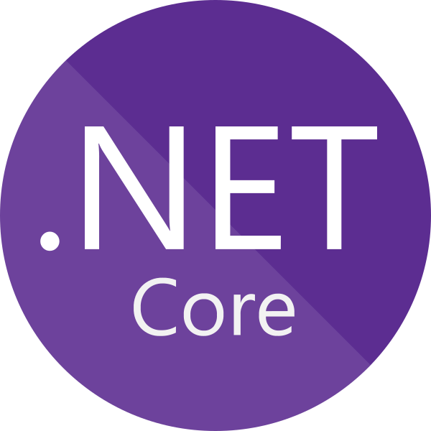
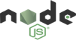
The benefits of using containers
Agility
+
Ship apps faster
Portability
+
Easily move workloads
Density
+
Achieve resource efficiency and cost-savings
Rapid scale
+
Scale easily to meet demand
Anywhere
Any app
Any language
Java
Python
On-premises
Cloud
Monolith
Microservice
.NET
Node
Notes:
Here we can see some of the features of containers that make them so useful and why containerization has become commonplace.
(Summarise)
Developers take responsibility for packaging all dependencies to run their apps.
They can and should where possible leverage external or backing services but the apps shouldn’t need any additional libraries or packages outside of their container images.
This is truly write-once, run anywhere.
Ops can focus on building skills and getting good at working with a container platform and not care about the implementation language or runtime (e.g. node, .net, java).
They will focus on monitoring, security, providing a platform to their development teams that is reliable, provides automated backups, and handles DR, and so on.
Other benefits include:
Immutability – knowing what is deployed to production is the same as what was built and tested in earlier envionrments
A single platform for all workload types (monolithic, microservices)
Supporting a fleet of machines, i.e. a cluster which is dynamic not static – this can be autoscaled to avoid overprovisioning and over-paying for resources
Bin packing, to achieve better VM utilization
Reproducibility (dev/prod parity) - package everything apps need inside the container
Simplifies DevOps practices and automation – container platforms provide many features like desired state reconciliation so that we don’t need to write complex scripts

Slide 14

Intro to Kubernetes (K8s)

Slide 15
Challenges of a containerized world
As application development has moved towards a container-based approach, the need to orchestrate and manage the inter-connected resources becomes important
Load Balancing
Naming and Discovery
Logging and Monitoring
Debugging and Introspection
Networking
All of this…requires orchestration
Notes:
“Container-centric infrastructure”
Additionally: configuration management, debugging/introspection, identity and authorization
First of all.. You can run containers w/o any further infrastructure. Docker, Images and Go..
But you’ll super quickly face issues – for example how to distribute containers in a cluster? Where to start my Containers? What happens when a container or a container host failed? How to I distribute requests across multiple instances of an application or service? How to measure and how to scale applications based on load?
Load Balancing
Distributing traffic across containers at scale
Naming and Discovery
How do containers or groups find one another?
Logging and Monitoring
Keeping track of what containers are doing
Debugging and Introspection
Getting inside running containers
Networking
Differentiating container networks from host networks at scale

Slide 16
The elements of orchestration
Scheduling
Affinity/anti-affinity
Health monitoring
Failover
Scaling
Networking
Service discovery
Coordinated app upgrades
Notes:
Hence, why we need an orchestrator:
Automates the deployment, management, scaling, networking, and availability of containers
Managers the lifecycle of containers in large environments
Allow users to guide container deployment and automate updates, health monitoring, and failover procedures

Slide 17


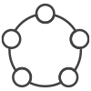
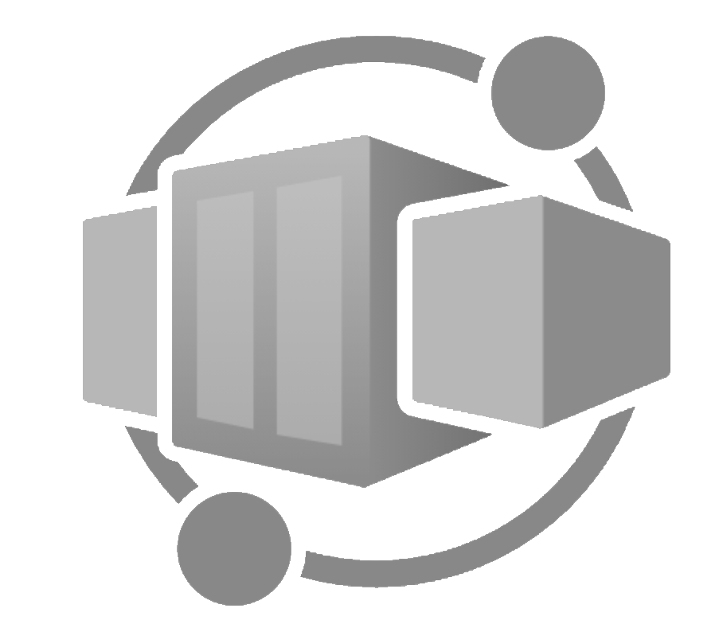
Kubernetes
App Service
Most widely used open-source container orchestrator
Azure Container Instances (ACI)
Kubernetes is "an open-source software for automating deployment, scaling, and management of containerized applications“
Originates from Greek meaning “helmsman” or “pilot of the ship”
Open-source project created by Google in 2014 and donated to Cloud Native Computing Foundation in 2015
Microsoft’s Brendan Burns was a co-creator
The operating system for the cloud native applications
Azure Container Registry (ACR)
Service Fabric
Azure Container Apps
Azure Kubernetes Service (AKS)
Notes:
Mention that Azure K

Slide 18
Why Kubernetes?
App Service
Azure Container Instances (ACI)
Many struggles with administration and management of container workload
Framework to run the distributed systems resiliently
Areas Kubernetes will provide for you
Service Discovery and Load Balancing
Storage Orchestration
Automated rollouts and rollbacks
Automatic bin packing
Self healing
Secret and configuration management
Azure Container Registry (ACR)
Service Fabric
Azure Container Apps
Azure Kubernetes Service (AKS)
Notes:
Mention that Azure K

Slide 19
Kubernetes
App Service
The de-facto orchestrator
Azure Container Instances (ACI)
Azure Container Registry (ACR)
Service Fabric
Portable
Public
Private
Hybrid
multi-cloud
Extensible
Modular
pluggable
Hookable
composable
Self-healing
Auto-placement
auto-restart
auto-replication
auto-scaling
Azure Container Apps
Azure Kubernetes Service (AKS)
Notes:
Mention that Azure K

Slide 20
Kubernetes
App Service
Empowering you to do more
Azure Container Instances (ACI)
Azure Container Registry (ACR)
Service Fabric
Deploy your applications quickly and predictably
Scale your applications on the fly
Roll out new features seamlessly
Limit hardware usage to required resources only
Azure Container Apps
Azure Kubernetes Service (AKS)
Notes:
Mention that Azure K

Slide 21
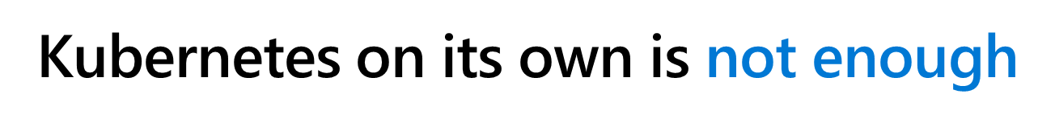
What Kubernetes is not?
App Service
Azure Container Instances (ACI)
Kubernetes is not a traditional all-inclusive PaaS
Default solutions are optional and pluggable
Kubernetes does not:
limit the types of applications supported
deploy source code and does not build your application
provide application-level services, such as middleware, data-processing frameworks, databases, caches, nor cluster storage systems as built-in services
dictate logging, monitoring, or alerting solutions
nor mandate a configuration language/system
Azure Container Registry (ACR)
Service Fabric
Azure Container Apps (Preview)
Azure Kubernetes Service (AKS)
Notes:
Mention that Azure K

Slide 22
How Do You Manage Kubernetes?
Kubectl is the official command line utility needed to interact with the Kubernetes cluster and resources running upon it
Kubectl connects to the cluster and calls into Kube Master APIServer
Type of commands include…
Generic commands – manage Kubernetes objects
Cluster management commands – manage the cluster
Troubleshooting commands
Deployment commands – deployment and scaling
Setting commands – configuration values
kubectl <command> <kubernetes object type> <object name> <flags>

Slide 23
What are Pods?
Deployment
Replica Set
The smallest building block in Kubernetes…
A collection of co-located containers and volumes
Running in the same execution environment
Managed as a single atomic unit
You never directly run a container, instead you run a POD
Apps running in a POD share the same IP, port and communicate using native interprocess communication channels
Pods are immutable - if a change is made to a pod definition, a new pod is created, and the old pod is deleted
PODs are identified using labels (key-value pairs)…
app=voting-app; tier= frontend
POD
Container
Notes:
Pods are the atomic unit of deployments.
- Why should we put multiple containers in a pod? The question we should ask is:
Will these containers work correctly if they land on different machines?
- Containers in a pod share same namespaces but have separate cgroups: This will allow us to fine tune resource limits for containers in a pod

Slide 24
Pods
Creating a POD
Notes:
Start with a kubectl run nginxpod --image=nginx
Show pod being create kubectl get pods
Forward traffic to the pod kubectl port-forward pod/nginxpod 8080:80
Browse to the site to display the Nginx landing page http://localhost:8080

Slide 25
Labels & Selectors
Deployment
Replica Set
POD
A declarative way for which to identify Kubernetes objects
Labels…
Simple key-value pair
Mechanism to attach arbitrary but meaningful metadata to an object
Ways for things in Kubernetes to find other things in Kubernetes
A Kubernetes object can have zero to many labels
Selectors…
Mechanism to filter for labels that match certain criteria or logic
Container
“labels” : {
“tier” : “staging”,
“type” : “redis”
}
tier = staging
type != nginx
Notes:
labels or annotations can both be used to attach metadata to Kubernetes objects
Labels can be used to select objects and to find collections of objects that satisfy certain conditions. In contrast, annotations are not used to identify and select objects.
Example of use case for labels: blue-green deployments
Define a routing logic (using Service objects) to route some traffic to tier=frontend and application=v1 <= Used by production traffic
Deploy new Pods as tier=frontend and application=v2
Define routing logic (using Service objects) to route some traffic to tier=frontend and application=v1 <= Used for smoke/validation test
Swap the production traffic from the v1 label to the v2 label.
Conclusion => labels are used to identify and select objects.
Annotation is to embed metadata inside the object,
The metadata in an annotation can be small or large, structured or unstructured, and can include characters not permitted by labels.
What can be stored as annotation:
- Fields managed by a declarative configuration layer. Attaching these fields as annotations distinguishes them from default values set by clients or servers, and from auto-generated fields and fields set by auto-sizing or auto-scaling systems.
- Build, release, or image information like timestamps, release IDs, git branch, PR numbers, image hashes, and registry address.
- Pointers to logging, monitoring, analytics, or audit repositories.
- Client library or tool information that can be used for debugging purposes: for example, name, version, and build information.
- User or tool/system provenance information, such as URLs of related objects from other ecosystem components.
- Lightweight rollout tool metadata: for example, config or checkpoints.
- Phone or pager numbers of persons responsible, or directory entries that specify where that information can be found, such as a team web site.
Source: https://kubernetes.io/docs/concepts/overview/working-with-objects/annotations/

Slide 26
Labels
Assign a Label to a POD
Notes:
https://kubebyexample.com/concept/labels
Show the label for the Pod created earlier kubectl get pods --show-labels
Create a new pod with a label kubectl run podwithlabels --image=nginx -l app=myfirstapp
Show all pods with labels again
Show only pods that have a certain label kubectl get pods --selector app=myfirstapp
**Cleanup kubectl delete pod/nginxpod pod/podwithlabels

Slide 27
What are Replica Sets?
Deployment
Replica Set
POD
A POD is essentially a one-off singleton instance
Replica Sets are a Kubernetes object that manage PODs
Redundancy –allow for failure
Scale –allow for more requests to be processed
They monitor the cluster and ensure the desired number of PODs are correctly running
If no PODs are provisioned, the Replica Set Controller will schedule them
If actual count drops below the desired, the controller will schedule replacements
If you exceed the desired count, the controller would destroy them
Replica sets are created by and managed through Kubernetes Deployment objects
Container
Notes:
A ReplicaSet's purpose is to maintain a stable set of replica Pods running at any given time.
As such, it is used to guarantee the availability of a specified number of identical Pods.

Slide 28
What are Deployments?
Deployment
Replica Set
POD
A Kubernetes object that you use to control the running state of PODs and replicas…
Instruct the Kubernetes Deployment controller how to create, scale and update
instances of your services
Provide fine-grained control over how and when a new pod version is rolled out as well as rolled back to a previous state
The Kubernetes Deployment Controller reads the deployment and schedules the service instances onto individual nodes in the cluster
Deployment objects abstract provisioning operations…
To delete a set of pods, simply delete the deployment that controls them
To update a set of pods, edit the deployment definition
Container
Notes:
Wrap replica set and provide administrative related features on top of that:
Self documented
Reproductible
Versioned
Simple rolling update and rollback
Deployment state lookup (progressing, complete, failed)
https://kubernetes.io/docs/concepts/workloads/controllers/deployment/#deployment-status

Slide 29
Deployments and Replica Sets
Show Replica Sets and Deployments
Notes:
https://thenewstack.io/kubernetes-deployments-work/
Create a Deployment/ReplicaSet kubectl create deployment mynginx --image=nginx --replicas=3
Show new resources kubectl get all --show-labels -o wide
Now delete one of the pods and show that a new pod was immediately created by the replicaset to replace the missing pod
Now Scale to 10 instances kubectl scale deployment.apps/mynginx --replicas=10
Show changes to replicaset and pods
Show updating image (deployment.apps/mynginx IMAGES will change) show rolling update
kubectl set image deployment/mynginx nginx=nginx:alpine
Show both replicasets
Rollback to previous image kubectl rollout undo deploy/mynginx

Slide 30
What is a Service?
Frontend Service
-- service selectors
tier=frontend
app=voting-app
An abstraction that defines a logical set of loosely-coupled PODs and a policy by which to access them
Defined with a YAML markup file
Use “selectors” to define which pods to include
Load balance traffic to PODs
Expose a frontend service to a public load balancer using selectors to bind to a specific POD
labels app=voting-app
tier=frontend
Backend Service
-- service selectors
tier=backend
app=voting-app
Worker node 1
Pod
Pod
Worker node 1
Pod
Notes:
Misleading generic term because it is actually a connector that can be thought of as a load balancer
To expose a set of pods internally to the cluster or externally.
Use label selectors to target particular pods.
This is what we could use to implement blue-green deployment when rolling out new pods (see previous slides for details).

Slide 31
Services
Kubernetes Services
Notes:
Create a service that exposes the deployment from the previous demo kubectl expose deploy/mynginx --port=80 --type=LoadBalancer
Watch the service get created and wait for the public ip address kubectl get svc
Talk about the service type = LoadBalance
Talk about the service Selector
Using your browser navigate to the public ip address
** Clean Up
kubectl delete svc/mynginx deploy/mynginx
Notice that when you delete a deployment is also deletes the replicaSet and Pods but NOT the service

Slide 32

Break
15 minutes
AKS Dev Day

Slide 33
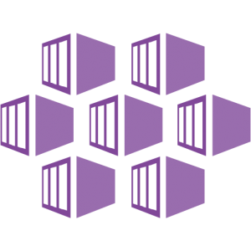

Container Orchestrators
Intro to Azure Kubernetes Service

Slide 34
Azure Kubernetes Service (AKS)
App Service
Simplify the deployment, management, and operations of Kubernetes
Azure Container Instances (ACI)
Azure Container Registry (ACR)
Deploy and manage Kubernetes with ease
Scale and run applications with confidence
Secure your Kubernetes environment
Service Fabric
Azure Container Apps (Preview)
Accelerate containerized application development
Work how you want with open-source tools & APIs
Set up CI/CD in a few clicks
Azure Kubernetes Service (AKS)

Slide 35
Manage Kubernetes with ease
Responsibilities | DIY with Kubernetes | Managed Kubernetes on Azure
Containerization
Application iteration, debugging
CI/CD
Provisioning, upgrades, patches
Reliability availability
Scaling
Monitoring and logging
Azure managed control plane
App/ workload definition
Self-managed master node(s)
Kubernetes API endpoint
etcd Store
User
API server
Scheduler
Controller Manager
Cloud Controller
Schedule pods over private tunnel
Customer VMs
containerd
containerd
containerd
containerd
containerd
Pods
Pods
Pods
Pods
Pods
Customer
Microsoft
Notes:
A Kubernetes cluster is typically made up of
Master nodes for system components like the API server, etcd store, and scheduler
Agent nodes for user container workloads
Managing the cluster involves:
Monitoring the API server
Ensuring HA/DR for the etcd store
Safely managing upgrades across Kubernetes versions
Safely scaling the cluster in and out
Patching master and agent VM nodes
And on and on…
This is complex, error-prone, and expensive
A managed service like AKS moves those tasks to the cloud provider

Slide 36
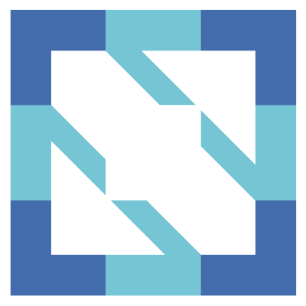
Azure Kubernetes Service (AKS)
App Service
Additional benefits
Azure Container Instances (ACI)
Free! You only pay for worker nodes in cluster, not for the masters
Management of your service through Azure portal
CNCF-certified as Kubernetes conformant.
AKS is compliant with SOC, ISO, PCI DSS, and HIPAA
Azure Container Registry (ACR)
Service Fabric
Azure Container Apps (Preview)
Azure Kubernetes Service (AKS)

Slide 37
AKS Features wrap-up
High Availability
High Reliability
Cluster Autoscaler
Security
Monitoring
Availability Zones
99.95% SLA
Self-Healing
Node Autoscaler
Virtual Nodes
Azure Key Vault
Azure Active Directory
Private Clusters
Azure Log analytics with Container Insights
Notes:
Availability Zones provide a higher level of availability to protect against a hardware failure or a planned maintenance event
Node Autoscaler - This ability to automatically scale up or down the number of nodes in your AKS cluster lets you run an efficient, cost-effective cluster. https://docs.microsoft.com/en-us/azure/aks/cluster-autoscaler
Virtual Nodes - To rapidly scale application workloads in an AKS cluster, you can use virtual nodes. With virtual nodes, you have quick provisioning of pods, and only pay per second for their execution time. Can handle overflow while nodes are being added to cluster.
Monitoring – a single analytics dashboard for all of Azure including Kubernetes. Can be used along with Promethius
https://docs.microsoft.com/en-us/azure/aks/monitor-aks

Slide 38
Demo Creating an AKS Cluster using the Azure Portal
Notes:
Go in to Azure and create a cluster

Slide 39
AKS – References
Documentation, learn, best practices, industry use cases

Slide 40

AKS References
Azure Kubernetes Service landing pages
Azure Kubernetes Service portal
Azure Kubernetes Service pricing
Azure Kubernetes Service documentation
Azure Kubernetes Service education
Azure Kubernetes Service learning path
Azure Kubernetes Service 50 days challenge
Azure Developer Cloud Skills Challenge

Slide 41
Deploying Applications to AKS

Slide 42
Different ways to deploy apps to AKS
Azure DevOps
Github
Bitbucket
Visual Studio
Visual Studio Code
Azure CLI
ARM Templates
Terraform
Jenkins
…and the list goes on

Slide 43
DevOps view of the container advantage
Fast iteration
Agile delivery
Immutability
Cost savings
Efficient deployment
Elastic bursting
For developers
For IT

Slide 44





Deliver
with Azure DevOps
Azure Boards
Azure Repos
Azure Pipelines
Azure Artifacts
Azure Test Plans

Slide 45
What is GitHub
A development platform that enables to
Host code
Review code
Manage projects
Build software
Provides DevOps features
Use Git as its core technology

Slide 46
Key features of GitHub
Issues
Pull requests
Notifications
Labels
Branches
Cloning and Forking
Actions

Slide 47

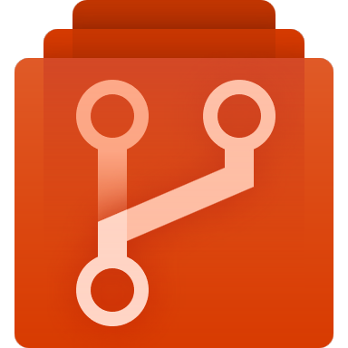

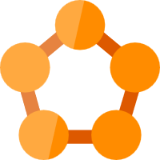
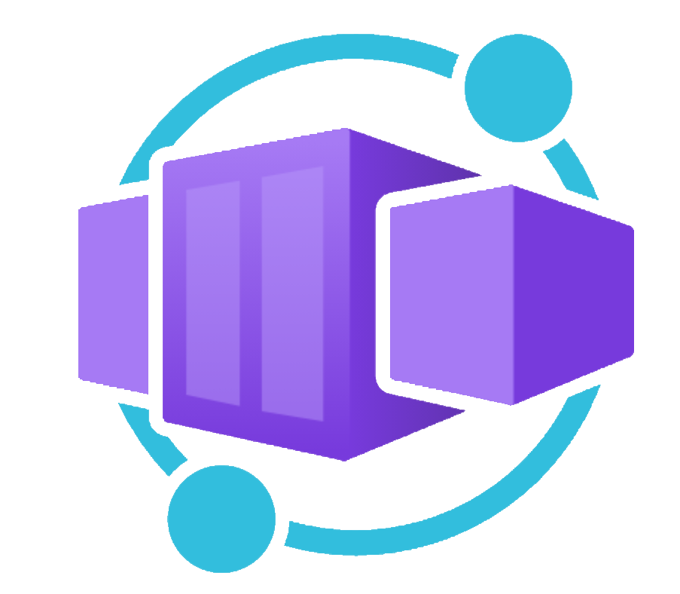


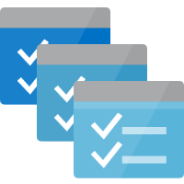

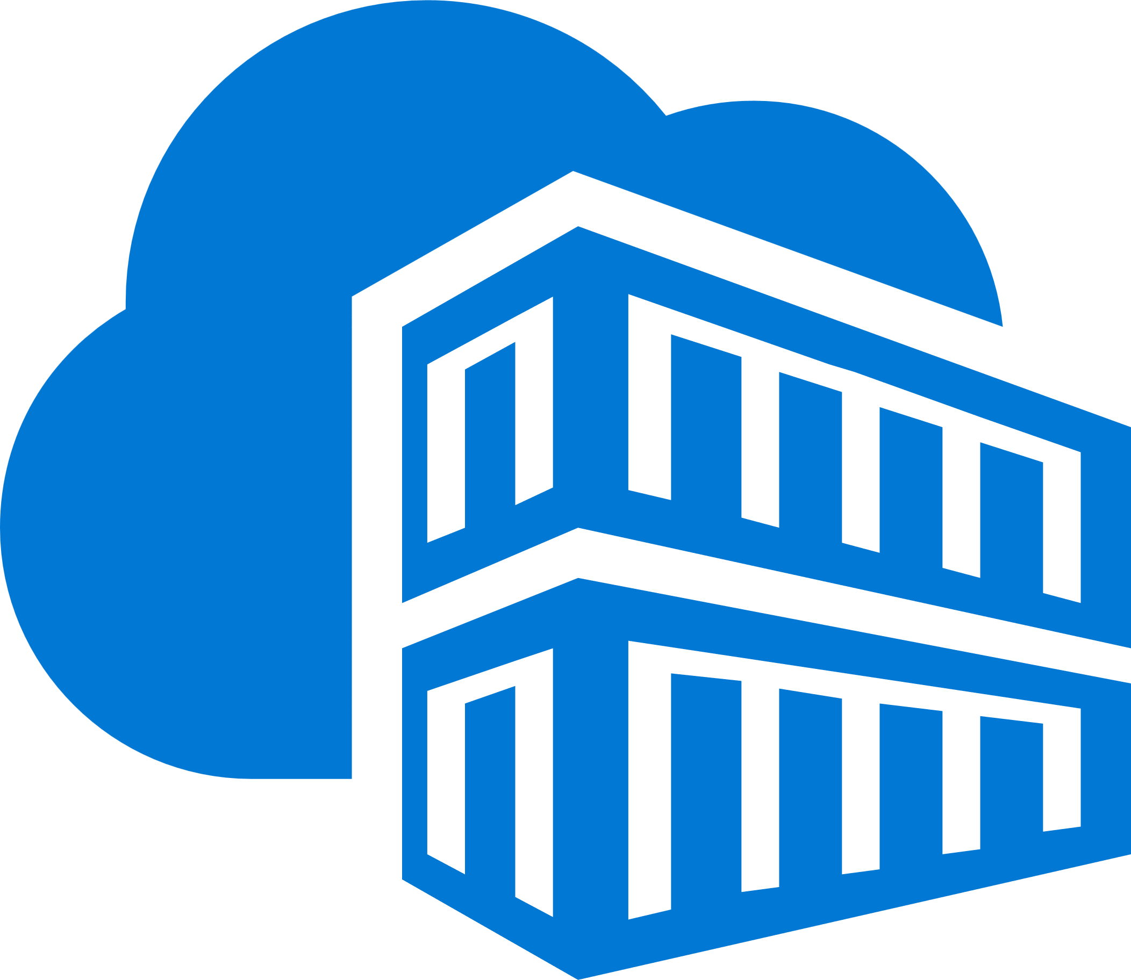
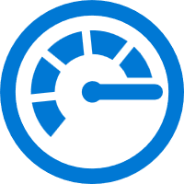

Containerized workflow pipeline
Build/CI,
Integrate,
Test
Source code control
CD, Deploy
Run
Developer Workstation
Azure Container Registry
VSCode
AKS Dev cluster
Test
Debug
Azure Monitor
Notes:
Here is an example of CI/CD pipeline for containerized application.
From the Dev box => build/run/test container
Push code to Source Control tool (Git) => at bottom left corner
Repository lives in Azure Repos, Jankins, or GitHub
Your Push triggers a build which will:
Build the container
Push it to Registry
Pull the container
Test the container
After every successful build
Automatic deployment to Pre Prod environment: ACS, Service Fabric, …
Pull container from registry
Run Acceptation test
Every morning (scheduled)
Automatic deployment into Prod
Pull container from registry
Run Acceptation test
Manual validation => From Dev box -> monitoring through App insights or OMS (Operation Management suite) => last lab
OMS ⬄ System Center for the Cloud (same team working on it.)

Slide 48
Demo Review a Kubernetes YAML file
Notes:
Use the YAML file that will be used for the first lab

Slide 49
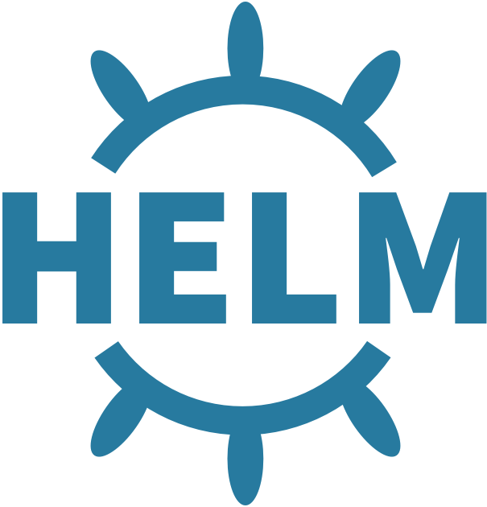
Helm
The package manager for Kubernetes
Why Helm?
Manage Complexity
Easy Updates
Simple Sharing
Rollbacks
Notes:
The best way to find, share, and use software built for Kubernetes
Manage complexity:
Helm Charts helps you define, install, and upgrade even the most complex Kubernetes application
Charts can describe complex apps; provide repeatable app installs, and serve as a single point of authority
Easy updates:
Take the pain out of updates with in-place upgrades and custom hooks
Simple sharing:
Charts are easy to version, share, and host on public or private servers
Rollbacks:
Use helm rollback to roll back to an older version of a release with ease

Slide 50
Helm
Package manager for Kubernetes-based applications
Streamlines installing/managing applications
Perform consistent releases without dealing with dozens of files
Update/rollback releases - as needed
Package and preconfigure Kubernetes resources into Charts
Manage and share your own application chart packages
Leverage other popular software packaged as charts
Create reproducible builds of Kubernetes applications
Manage you Kubernetes manifest files
Notes:
You are recommended to read more details about Helm at: https://docs.helm.sh. You should talk about why its
important to use tool like Helm (each bullet call out part of its use case). Make sure to explain the idea behind helm
is to minimize the time it takes to work with individual YAML files, package them and share them with others.
Charts are explained in detail at: https://docs.helm.sh/developing_charts
Keep in mind that the Helm demo (later) will provide you with an opportunity to showcase lot
more about Helm than you can talk about now, so keep technical details to minimum.

Slide 51
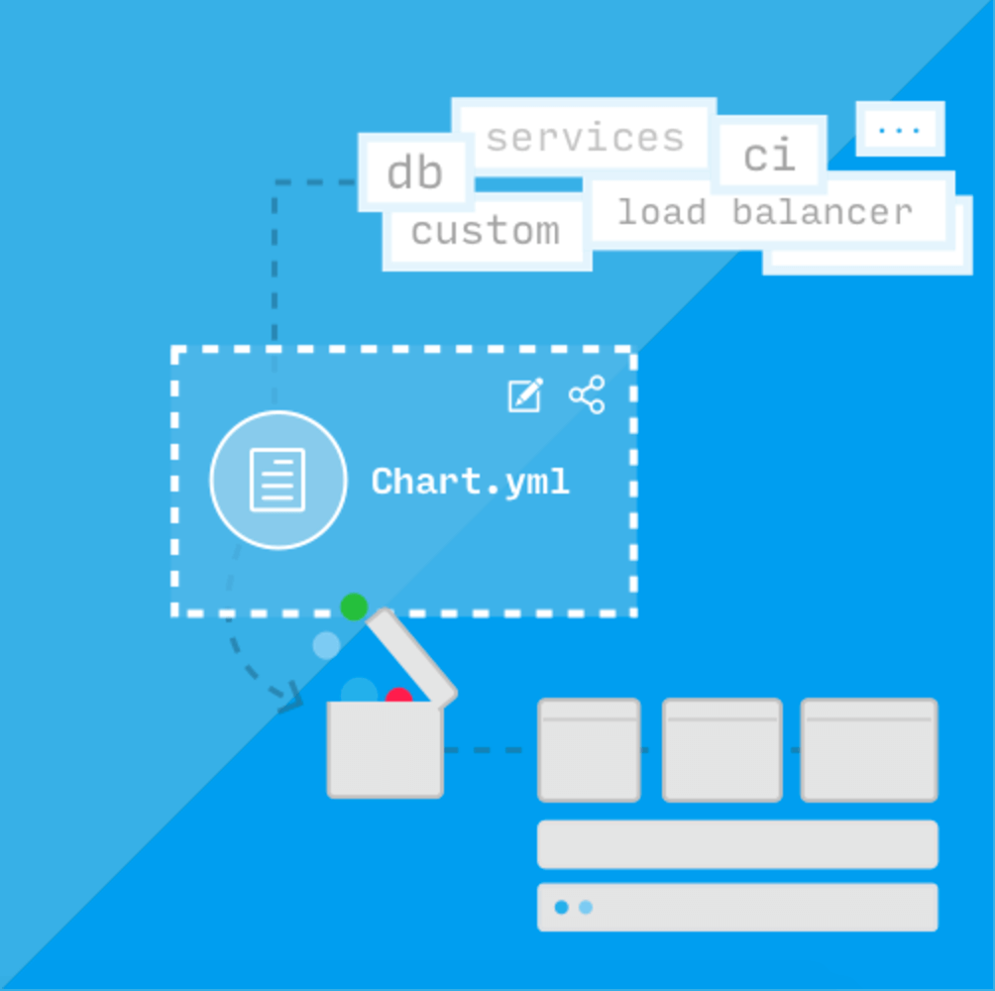
Helm | Charts
Helm packages are called Charts
Chart.yaml describes the chart
Charts contains one or more templates
Charts can be persisted on disk, or pulled from remote chart repositories (e.g. GitHub, private blob on Azure)
Azure Container Registry can be used as a Helm chart repository
Private, secure, integrates with build pipelines
Provides geo-replication
Notes:
One of the best ways to understand helm charts is by looking at the charts that are available at Github:
1. Helm Charts - https://github.com/helm/charts/tree/master/stable
2. (Best practices example) OpenStack: https://github.com/openstack/openstack-helm
Note: In the next demo you will be providing walkthrough of most of the key elements and workings of charts. So don’t spend too much time right now but
establish the fact that helm charts are used in production by large organizations.

Slide 52
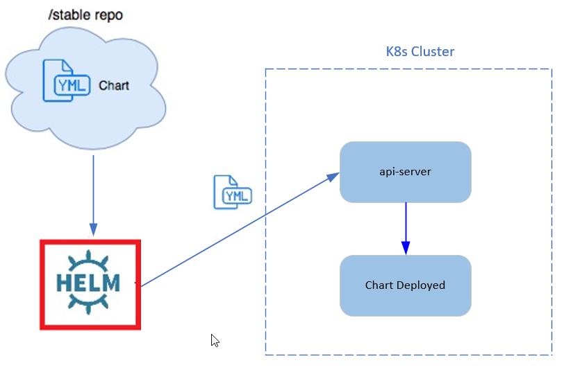
Helm Architecture
Helm has client/server architecture
Helm CLI is a client-side component – runs on your dev machine
Helm CLI talks directly to K8s api-server component
Notes:
You are recommended to read more details about Helm at: https://docs.helm.sh. You should talk about why its
important to use tool like Helm (each bullet call out part of its use case). Make sure to explain the idea behind helm
is to minimize the time it takes to work with individual YAML files, package them and share them with others.
Charts are explained in detail at: https://docs.helm.sh/developing_charts
Keep in mind that the Helm demo (later) will provide you with an opportunity to showcase lot
more about Helm than you can talk about now, so keep technical details to minimum.

Slide 53
Demo Working with HELM packages
Notes:
Install Wordpress Blog
helm repo add bitnami https://charts.bitnami.com/bitnami
helm search hub bitnami/wordpress
helm install my-blog bitnami/wordpress
Review output and wait for load balancer to get an ip address
helm list
Talk about revisions and rollbacks for entire applications
5. helm show values bitnami/wordpress

Slide 54
Lunch
45 minutes
AKS Dev Day

Slide 55

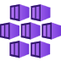
Lab
Deploy a containerized application to AKS
Azure Container Registry
AKS
Deploy a containerized application on Azure Kubernetes Service - Training | Microsoft Docs
Notes:
https://aka.ms/azuredevdaylabs

Slide 56
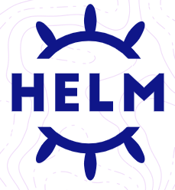
Lab
Application and Package Management using HELM
AKS
Application and package management using Helm - Training | Microsoft Docs
Notes:
https://aka.ms/azuredevdaylabs

Slide 57
Scaling

Slide 58
Benefits of Autoscaling
Cost | Allows for dynamic allocation of Cloud resources
Ops | Eliminates the need to respond manually to events that may require scale up or down
Security | Protects against failures by detecting and replacing unhealthy instances
Flexibility | Scale can take place for the number of pods and/or the number of nodes
Notes:
Although there are many benefits to autoscaling, these are just to highlight a few and the area of focus where the benefit would show

Slide 59
Predictive vs Scheduled Autoscaling
By default, autoscaling is dynamic and reactive by nature when enabled
Rapid scaling needs may make reactive scaling less effective
Reactive | Default for Kubernetes when enabled
Predictive | Uses predictive analytics and uses historical data Based on predictions about usage in the future Ready's capacity slightly in advance Better for variable patterns, but requires historical analysis
Scheduled | Functions in real time, but hybrid Anticipates known changes in load and scales before predicted load Responds to key events faster because scaling has already be implemented

Slide 60
Horizontal Pod Autoscaling

Slide 61
Horizontal pod autoscaling
Used to update the number of pods in a Deployment or Stateful set
A response to increased load to deploy more pods on the nodes
If the load decreases, the number of pods will be reduced down to a minimum number of pods
Notes:
We do not specifically discuss stateful sets in this presentation
It may take longer to scale down than to scale up

Slide 62
Kubernetes HorizontalPodAutoscaler (HPA)
Implemented as a Kubernetes API resource and a controller
The HPA controller runs within the Kubernetes control plane
The HPA periodically adjusts the desired scale of its target (Deployment)
Typical metrics used by the HPA are CPU and/or Memory utilization but you can also have custom metrics
The HPA is not deployed into your cluster by default

Slide 63
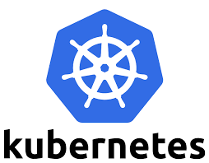
How does the HPA work?
Metrics Server
2. Calculate # Pods
Pod 1
Pod 2
….
Pod N
Horizontal Pod Autoscaler
ReplicaSet
1. Query for metrics
Deployment
ReplicaSet Controller
Scale
3. Scale to desired pod level
StatefulSet
Application
Notes:
The controller fetches the pod metrics from the metrics server.
If the target utilization is set for the pod, the controller calculates the utilization value as a percentage of the resource request.
The controller then takes the ‘mean’ of the utilization across all pods and produces a ratio used to scale the number of pods

Slide 64
Demo HorizontalPodAutoscaler
Notes:
Tutorial: https://kubernetes.io/docs/tasks/run-application/horizontal-pod-autoscale-walkthrough.
Make sure you have at least a two node AKS cluster. If you followed the pre-requisites and steps, you are ready to go.
Go to the Scaling\Demos repository and click on Code, then Codespace and open a new codespace. You should find yourself in VS Code.
Open two terminal windows and log in to Azure in both of them. Use ‘az login –use-device-code’
Run az aks get-credentials in both windows
In the root folder of the content you will find a file .\Demo1-HPA\apache\php-apache.yaml, this is your deployment/source file. Go over this with viewers.
Deploy kubectl apply –f php-apache.yaml
Either using kubectl or by looking in the cluster, confirm the deployment is running.
Open and review the hpa file, myhpa.yaml and then deploy it ‘kubectl apply –f myhpa.yaml’
Check the status of the hpa ‘kubectl get hpa’
Now you want to increase the load, run the command line :
kubectl run -i --tty load-generator --rm --image=busybox:1.28 --restart=Never -- /bin/sh -c "while sleep 0.01; do wget -q -O- http://php-apache; done"
9. In the other terminal window, watch the change in the hpa: kubectl get hpa php-apache –watch
10. Scale back down by ending the load generator pod by doing CTRL+C
11. Look at the watch statement again to make sure the load has gone down.
(azure-voting-app-redis), review the docker-compose.yaml file with audience. It does not have anything in it regarding HPA at this point. You will be running this locally so make sure the port isn’t blocked on your machine (port 8080). If its blocked, use a different port. This step of running the sample before the HPA is step 4.
For step 5, start off by showing the HPA code at azure-vote-hpa.yaml

Slide 65
Horizontal pod autoscaling limitations
When you set a request amount for memory/CPU, the cluster will hold that much of the resource even if its not used
Requests may mean that your nodes have unused resources, but you still can’t use the resources because of your settings
HPA should be used with the cluster autoscaler to get full capability
Notes:
https://cloud.google.com/kubernetes-engine/docs/concepts/horizontalpodautoscaler#limitations
Do not use the Horizontal Pod Autoscaler together with the Vertical Pod Autoscaler on CPU or memory. You can use the Horizontal Pod Autoscaler with the Vertical Pod Autoscaler for other metrics.
If you have a Deployment, don't configure horizontal Pod autoscaling on the ReplicaSet or Replication Controller backing it. When you perform a rolling update on the Deployment or Replication Controller, it is effectively replaced by a new Replication Controller. Instead configure horizontal Pod autoscaling on the Deployment itself.

Slide 66
What is KEDA?
Kubernetes Event Driven Autoscaler
Allows you to drive the scale of any container in Kubernetes based on the number of events needing to be processed
Works alongside HPA to extend scaling functionality
KEDA has an agent that activates/deactivates deployments to scale to/from zero on event notification
KEDA acts as a Kubernetes metrics server that exposes information like queue length or stream lag
Notes:
https://keda.sh/

Slide 67
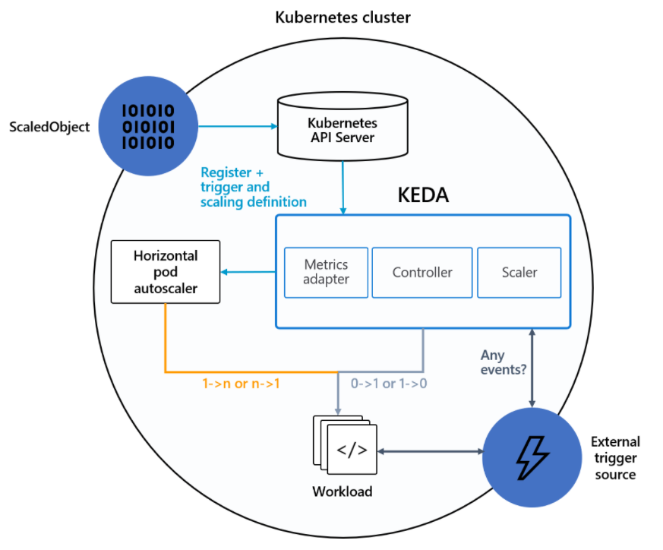
KEDA Architecture
ScaledObject configures scale range
KEDA installed
Horizontal pod autoscaler
continues to scale
External Event is triggered
Notes:
https://keda.sh/docs/2.6/concepts/
This diagram shows how KEDA works in conjunction with the K8s HPA, external event sources and etcd data. HPA works as it normally would with request limits set but the workload itself could be supplied by events

Slide 68
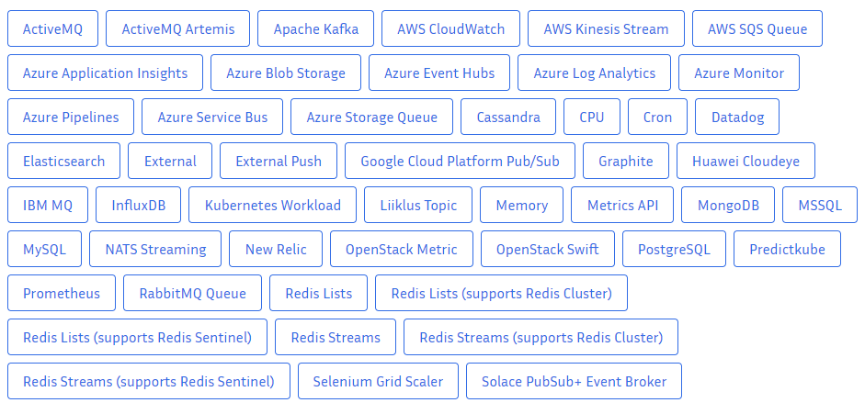
Currently available scalers for KEDA
KEDA scalers can both detect if a Deployment should be activated or deactivated, and feed custom metrics for a specific event source

Slide 69
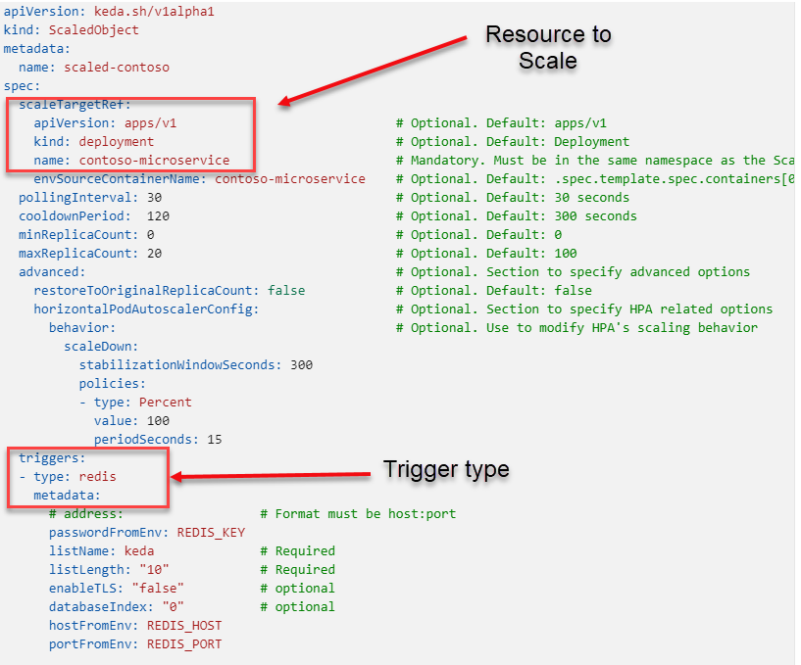
ScaledObject YAML

Slide 70
What is required to use KEDA?
Install KEDA onto your cluster https://keda.sh/docs/2.6/deploy/
Deploy a ScaledObject that represents what your scale will be triggered on
Configure and deploy HorizontalPodAutoscaler
Deploy application
Notes:
https://keda.sh/

Slide 71
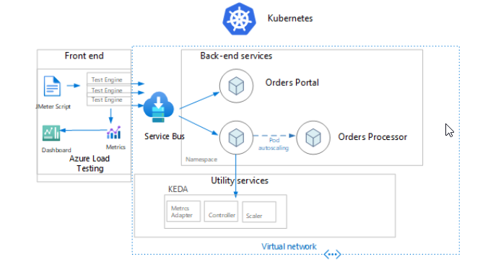
Demo architecture
Notes:
https://keda.sh/

Slide 72
Demo Scaling with KEDA and Azure Service Bus
Notes:
The source of this demo comes from the Advanced Autoscaling workshop https://azure.github.io/aks-advanced-autoscaling/. The source code was placed into our own repository in case changes were made we had not tested. You will need to setup the environment, start in module 0 and show code spaces.
Module 0 – You can setup your own environment or you can go to Codespaces
Module 1 – Deploy the infrastructure, you should have this done before the first demo, but just in case….
Module 2 – ./Demo3-4-ACI-Keda/docs/modules/Module2/index.md. This is the demo you are doing, refer to the architectural diagram. You need to have already installed KEDA in your cluster, unless you just want to do it here. Walk the students through the instructions for the module and explain why you have to have secrets etc for accessing Azure Service Bus. Follow the steps for the lab, using Azure Load Testing to test the scaling

Slide 73
What is cluster autoscaling?
The ability to use metrics to scale out the number of nodes you have in your nodepool
The autoscaler watches for pods that can’t be scheduled because of resource constraints
Nodes are also checked for a lack of running pods and will scaled down
The cluster autoscaler is not enabled by default

Slide 74
Using HPA with cluster autoscaling
The HPA is typically setup to work with the cluster autoscaler
Without the cluster autoscaler, the HPA may scale out the number of pods, but cannot create more pods than will fit on the existing nodes
The HPA is responsible for scaling in/out pods, the cluster autoscaler watches the number of pods
The cluster autoscaler may scale down the number of nodes by moving pods to other nodes

Slide 75
When cluster scale down may not work
When a pod is directly created and isn’t backed by a deployment or replicaset (created with kubectl)
When a pod disruption budget (PDB) does not allow the number of pods to fall below a certain threshold
When a pod uses node selectors or anti-affinity that can’t be honored if scheduled on a different node

Slide 76
Break
15 minutes
AKS Dev Day

Slide 77
Lab
Scalability on AKS using the HorizontalPodAutoscaler
AKS
Application scalability on AKS with HorizontalPodAutoscalers - Training | Microsoft Learn

Slide 78
Lab
Scaling container applications in AKS using KEDA
AKS
Scale container applications in Azure Kubernetes Services (AKS) using KEDA - Training | Microsoft Learn
Notes:
https://aka.ms/azuredevdaylabs

Slide 79
Ingress

Slide 80
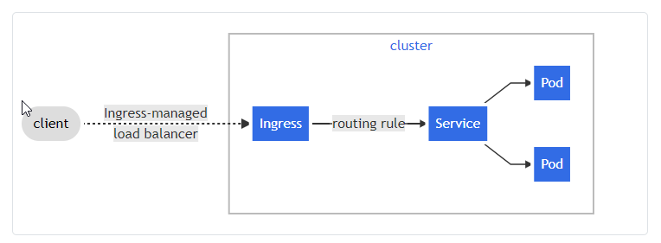
What is Ingress?
Exposes HTTP and HTTPS routes from outside the cluster to services within the cluster
Traffic routing is controlled by rules defined on the Ingress resource
You must have an Ingress-Controller defined to
satisfy the Ingress routing rules
Notes:
Ingress is an API object that provides routing rules to manage external users' access to the services in a Kubernetes cluster
Here is a simple example where an Ingress sends all its traffic to one Service:
An Ingress may be configured to give:
Services externally-reachable URLs,
load balance traffic,
terminate SSL / TLS,
Offer name-based virtual hosting.
An Ingress controller is responsible for fulfilling the Ingress, usually with a load balancer, though it may also configure your edge router or additional frontends to help handle the traffic.
An Ingress does not expose arbitrary ports or protocols. Exposing services other than HTTP and HTTPS to the internet typically uses a service of type Service.Type=NodePort or Service.Type=LoadBalancer.

Slide 81
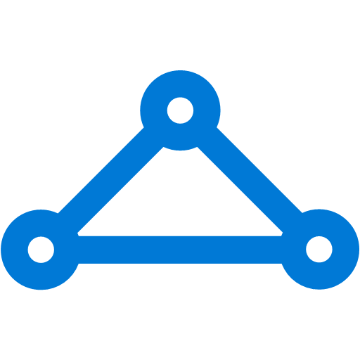
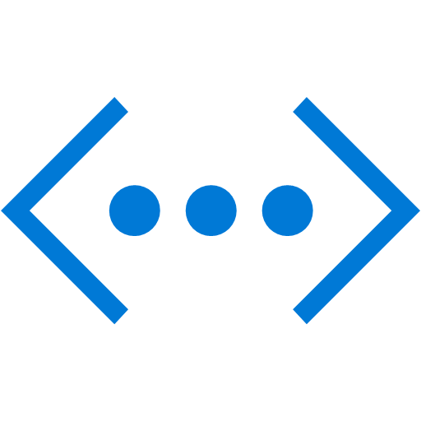
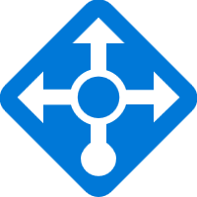

Ingress
On-premises infrastructure
Enterprise system
kind: Ingress
metadata:
name: contoso-ingress
annotations: kubernetes.io/ingress.class: PublicIngress
spec:
tls:
- hosts:
- contoso.com
secretName: contoso-secret
rules:
- host: contoso.com
http:
paths:
- path: /a
backend:
serviceName: servicea
servicePort: 80
- path: /b
backend:
serviceName: serviceb
servicePort: 80
Azure Express Route
Azure AKS VNet
Private IP
Public IP
Public LB
Internal LB
AKS subnet
AKS cluster
PublicIngress
PrivateIngress
contoso.com/A
contoso.com/B
serviceC.contoso.com
ServiceA
ServiceB
ServiceC
Notes:
https://docs.microsoft.com/en-us/azure/aks/operator-best-practices-network#distribute-ingress-traffic

Slide 82
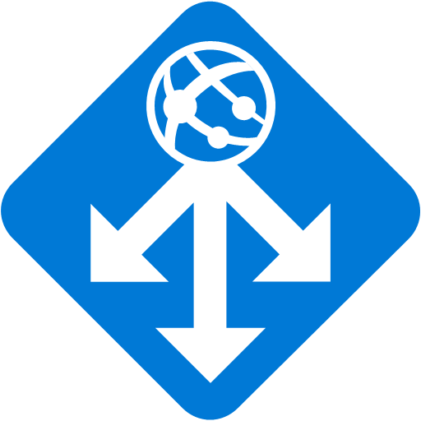
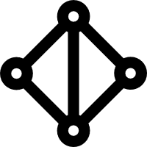
Securing Kubernetes Services with WAF
Azure Management VNET
APP GW Subnet
Azure AKS VNet
VNet peering
Private IP
AKS subnet
Internal LB
AKS cluster
Ingress
contoso.com/A
contoso.com/B
service.contoso.com
ServiceA
ServiceB
ServiceC
Notes:
https://docs.microsoft.com/en-us/azure/aks/operator-best-practices-network#secure-traffic-with-a-web-application-firewall-waf
A web application firewall (WAF) provides an additional layer of security by filtering the incoming traffic. The Open Web Application Security Project (OWASP) provides a set of rules to watch for attacks like cross site scripting or cookie poisoning. Azure Application Gateway (currently in preview in AKS) is a WAF that can integrate with AKS clusters to provide these security features, before the traffic reaches your AKS cluster and applications.

Slide 83
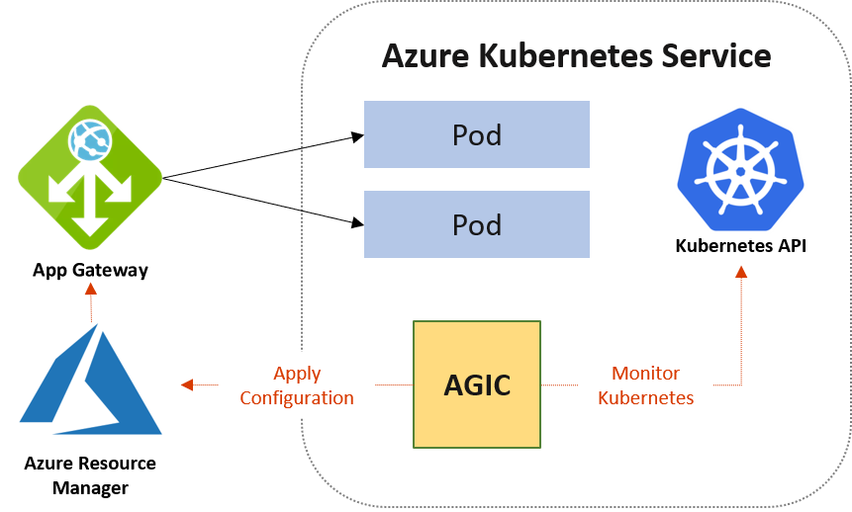
Application Gateway Ingress Controller
Attach Application Gateways to AKS Clusters
Load Balance from the Internet directly to pods
Features
URL routing
Cookie-based affinity
TLS termination
End-to-end TLS
Support for public, private, and hybrid web sites
Integrated web application firewall
Notes:
https://docs.microsoft.com/en-us/azure/application-gateway/ingress-controller-overview
AGIC helps eliminate the need to have another load balancer/public IP in front of the AKS cluster and avoids multiple hops in your datapath before requests reach the AKS cluster. Application Gateway talks to pods using their private IP directly and does not require NodePort or KubeProxy services. This also brings better performance to your deployments.

Slide 84
Ingress
Kubernetes Ingress
Notes:
OPTIONAL if time permits
Install Nginx Ingress Controller https://kubernetes.github.io/ingress-nginx/deploy/
helm upgrade --install ingress-nginx ingress-nginx --repo https://kubernetes.github.io/ingress-nginx --namespace ingress-nginx --create-namespace
Deploy guestbook.yaml app located in /ingress
kubectl create –f
Port forward to app and show ap running internally
kubectl port-forward service/guestbook-svc 8080:80
View then deploy ingress.yaml
In Portal, show backend pool and grab URL for App Gateway
Browse to App Gateway URL and show guestbook application. Invite team to post messages (work friendly)

Slide 85

Sign up for Microsoft.Source
Thank you!
Receive a regular digest of relevant technical content, events and training
Get the best of the newest resources, tools and guidance to help developers quickly build and deploy on Azure
Get the latest articles, documentation, and events from Microsoft.Source—the curated monthly developer community newsletter.
Stay at the forefront of rapidly evolving technologies with resources that are relevant to your field, location, and areas of interest—including articles, GitHub repositories, and how-to guides.
Get notified about events—from local hacks, workshops, and training sessions to virtual meetups and global conferences.
Learn what you want, when you want, how you want. Resources include in-person hands-on workshops, free, interactive online training and sandbox environments.

